Slide 1
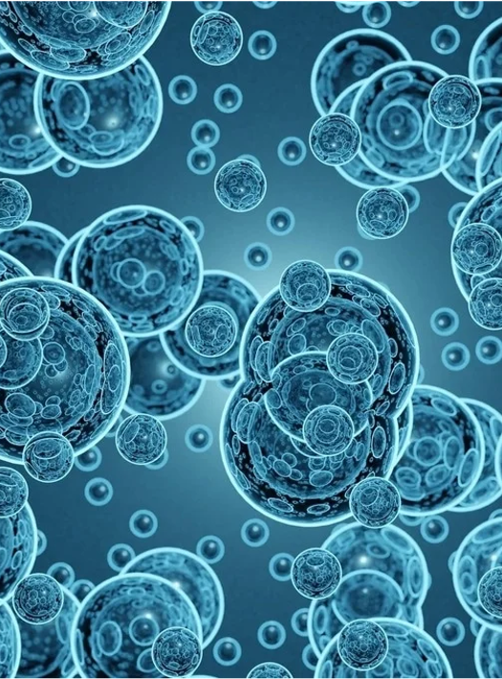
The role of biomimetic in drug delivery
By: Zahra Katoli
Nov 2022

Slide 2
Table of contents
Biomimetic
Insects
Plants
Virus

Slide 3
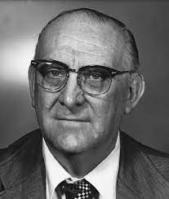
What is biomimetic?
Biologically inspired design or adaptation or derivation from nature is referred to as ‘biomimetic’
Biomimetic is derived from the Greek word biomimesis.
Art
Architecture
Biomimetic
Medicine
Otto Schmitt
1957
Engineering
Hwang, Jangsun, et al. "Biomimetics: forecasting the future of science, engineering, and medicine." International journal of nanomedicine 10 (2015): 5701.

Slide 4
Biomimetic
Without
using the biological system
With
using the biological system

Slide 5
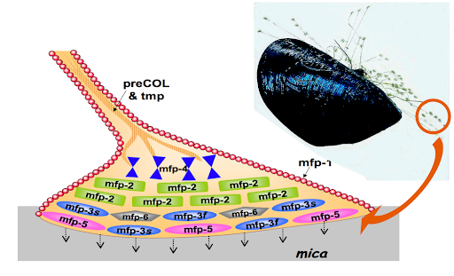
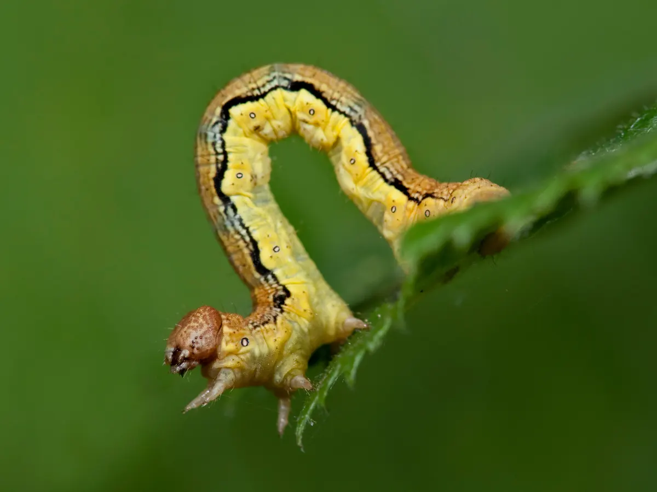
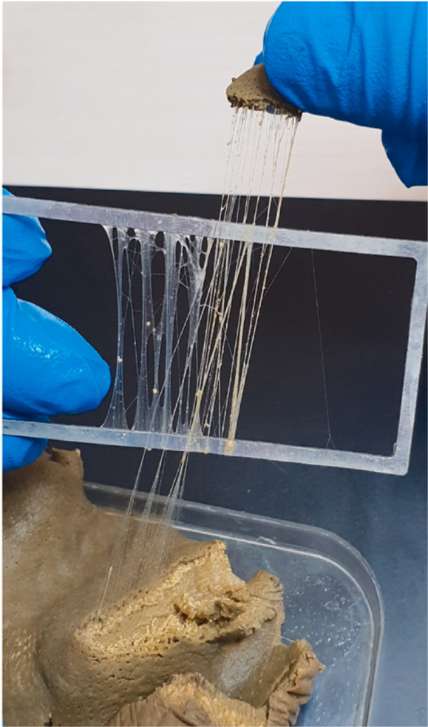
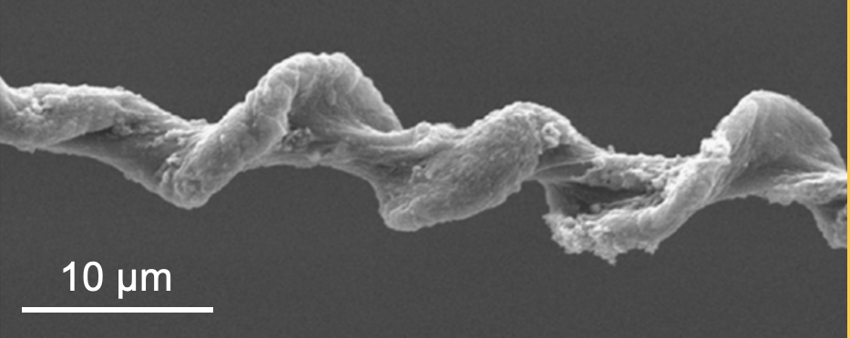
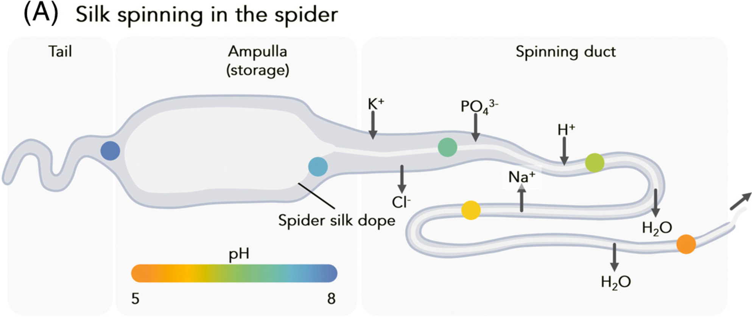
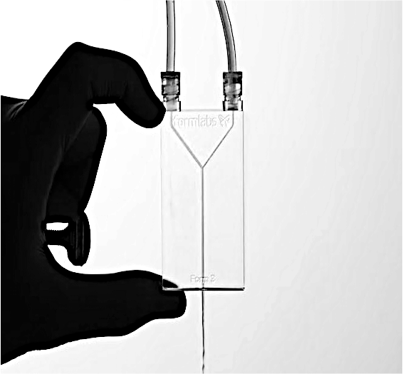
The area of applications in biomimetic
Suture
Stent
Hernia
vascular grafts
Fiber
Silkworm
Spider

Slide 6
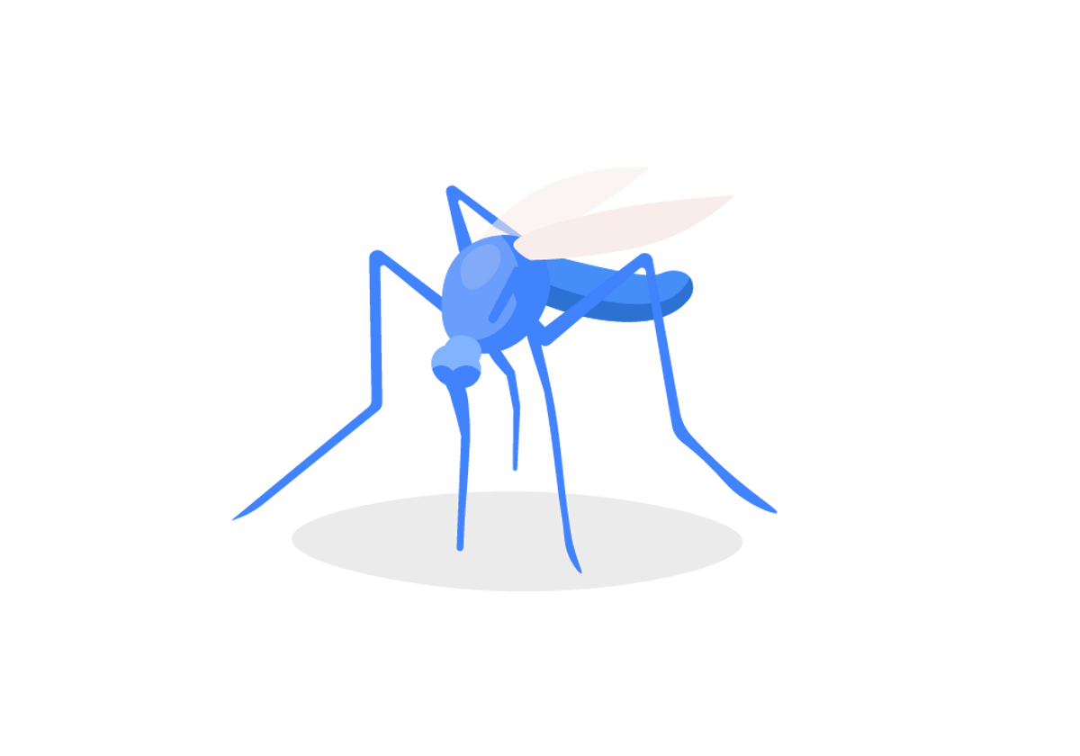
Lessons from Mosquitoes

Slide 7
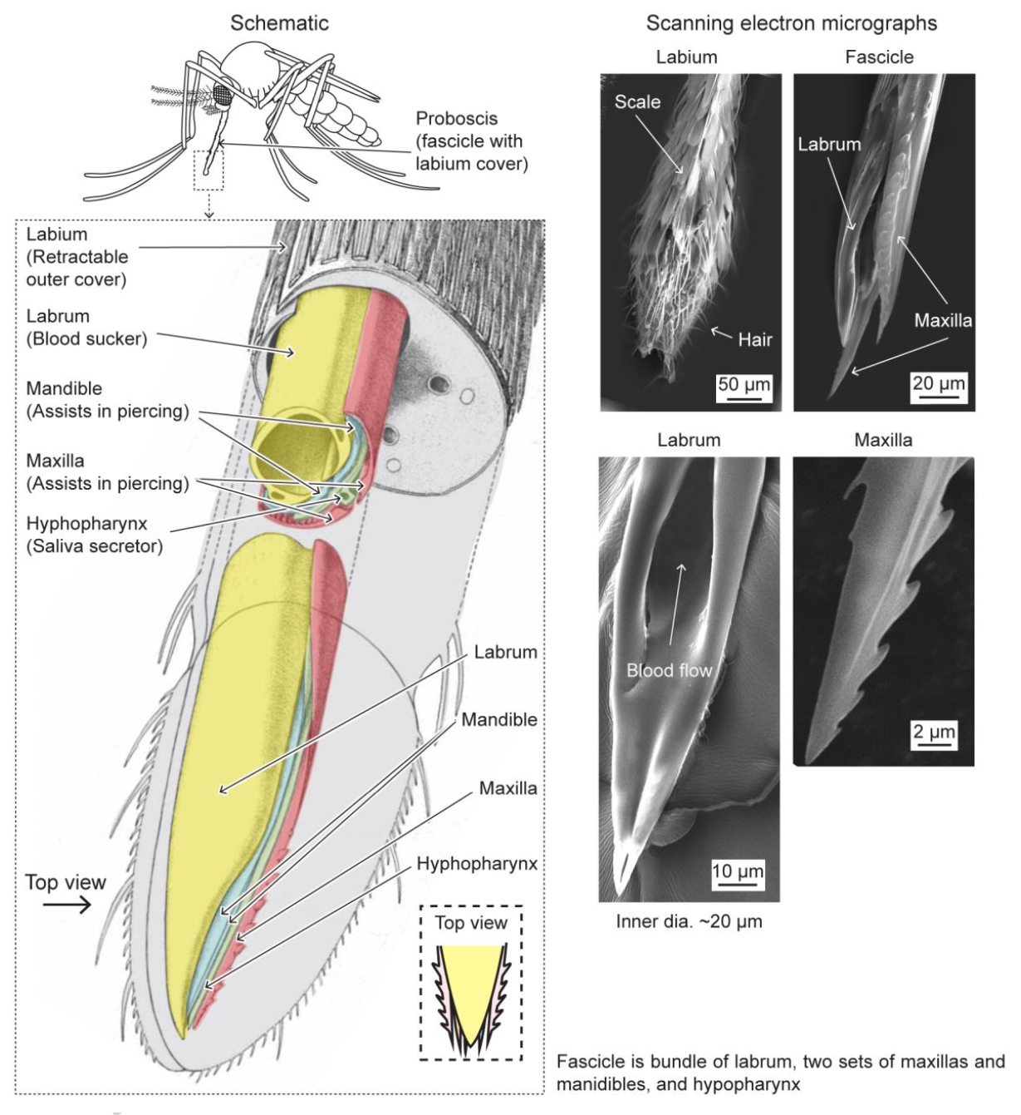
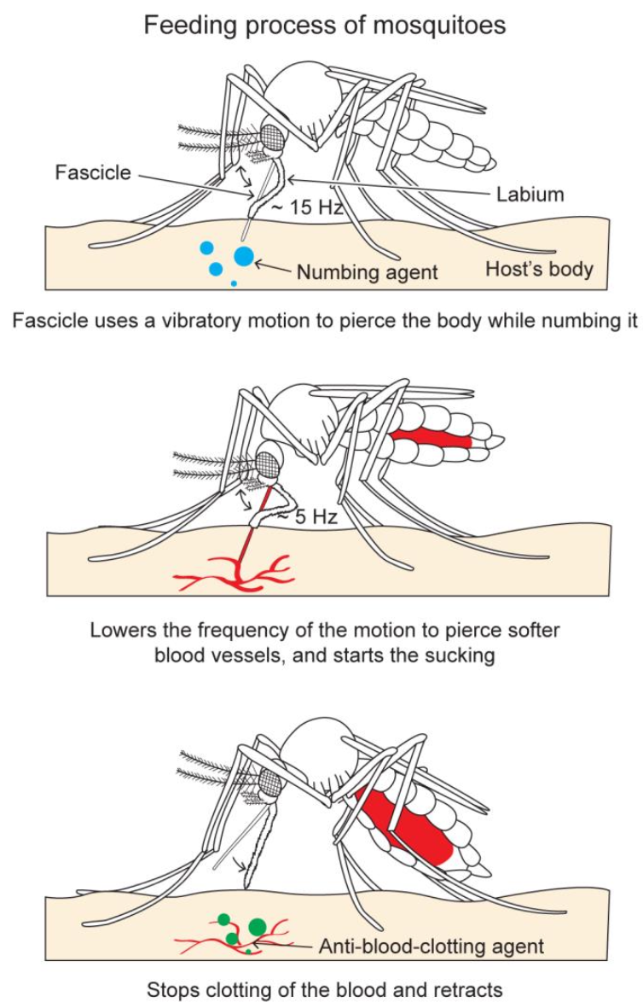
Painless piercing
Gurera, Dev, Bharat Bhushan, and Navin Kumar. "Lessons from mosquitoes’ painless piercing." Journal of the mechanical behavior of biomedical materials 84 (2018): 178-187.

Slide 8
Mosquito-inspired microneedle
Working mechanism
Gurera, Dev, Bharat Bhushan, and Navin Kumar. "Lessons from mosquitoes’ painless piercing." Journal of the mechanical behavior of biomedical materials 84 (2018): 178-187.

Slide 9
Pollen grain

Slide 10
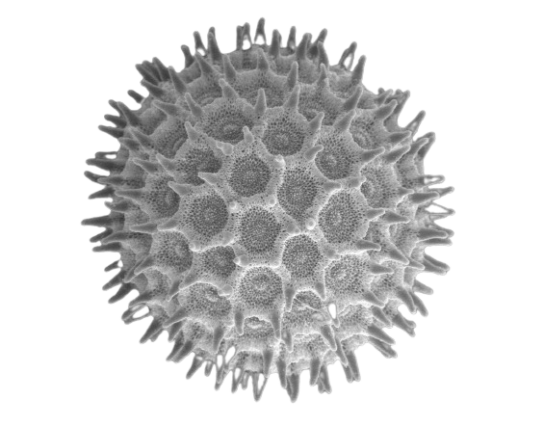
Advantages
Cost
effective
Environmentally
friendly
Ubiquitous
Regular
shape
Bio-
compatible
Uniform
size

Slide 11
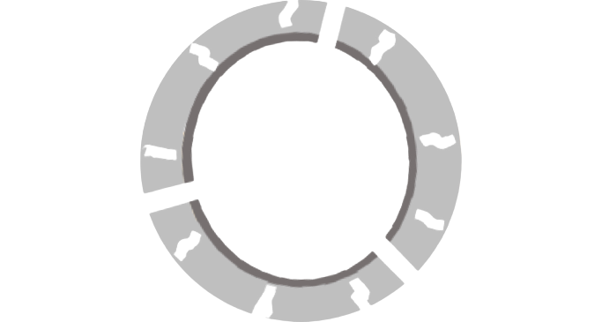
How to use
Acid enters
Water enters
Turgor pressure
Opened aperture
Clean pollen grain
Gonzalez-Cruz, Pedro, et al. "Chemical treatment method for obtaining clean and intact pollen shells of different species." ACS biomaterials science & engineering 4.7 (2018): 2319-2329.

Slide 12
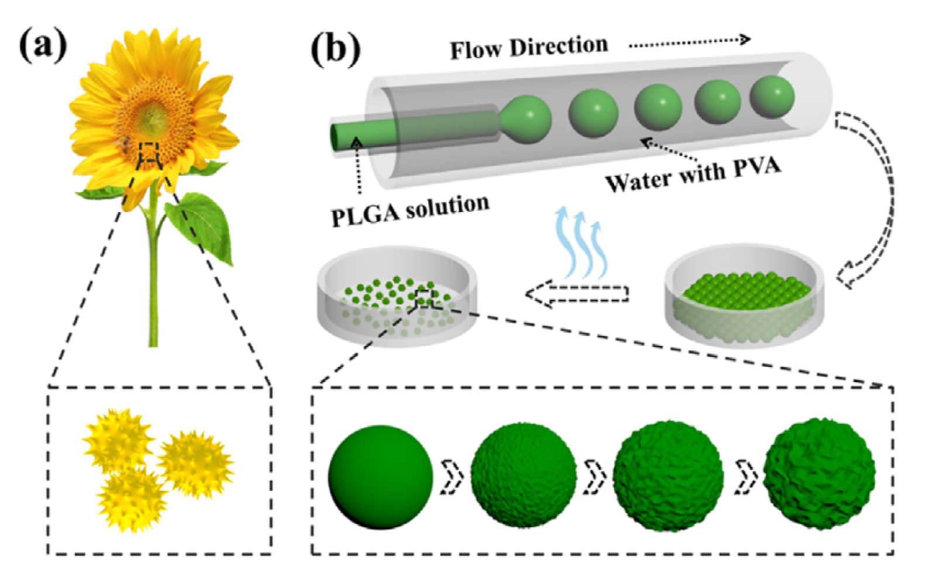
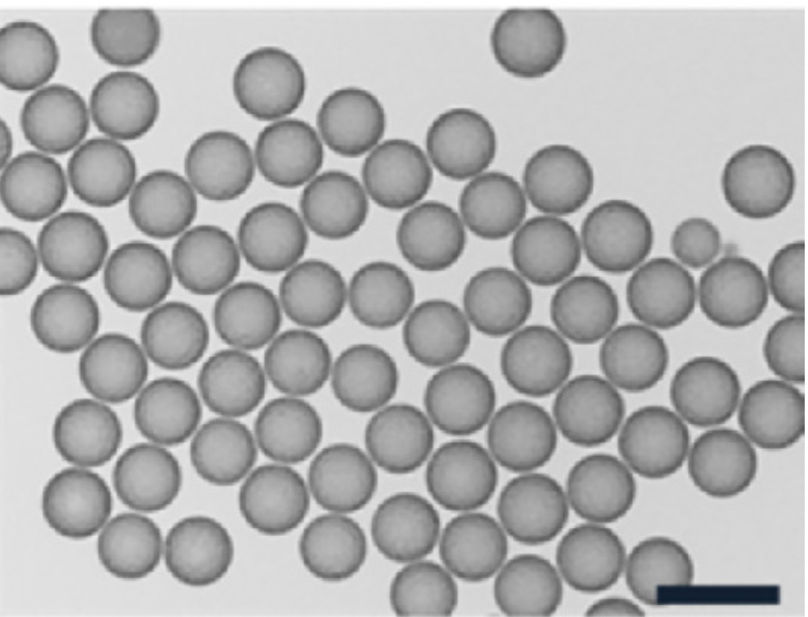
Pollen-inspired microparticles
100 μm
0.5 cm
Wang, Yuetong, et al. "Pollen-inspired microparticles with strong adhesion for drug delivery." Applied Materials Today 13 (2018): 303-309.

Slide 13
Pollen as a biotemplate
template
removal
Uncoated pollen
Calcium phosphate
Calcium carbonate
Silica
Hall, Simon R., Helen Bolger, and Stephen Mann. "Morphosynthesis of complex inorganic forms using pollen grain templates." Chemical Communications 22 (2003): 2784-2785.

Slide 14
Sundew
mucilage

Slide 15
Advantages
Swelling
and
shrinking
High porosity
Bio-compatible
Bio-degradable

Slide 16
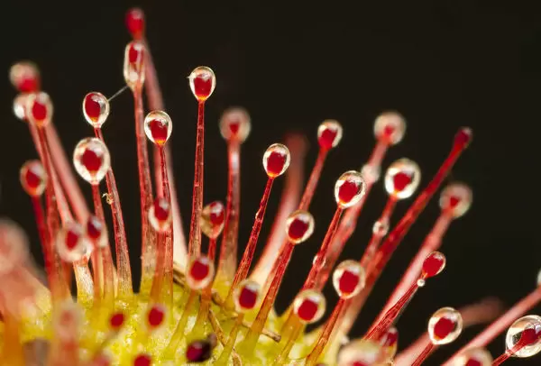
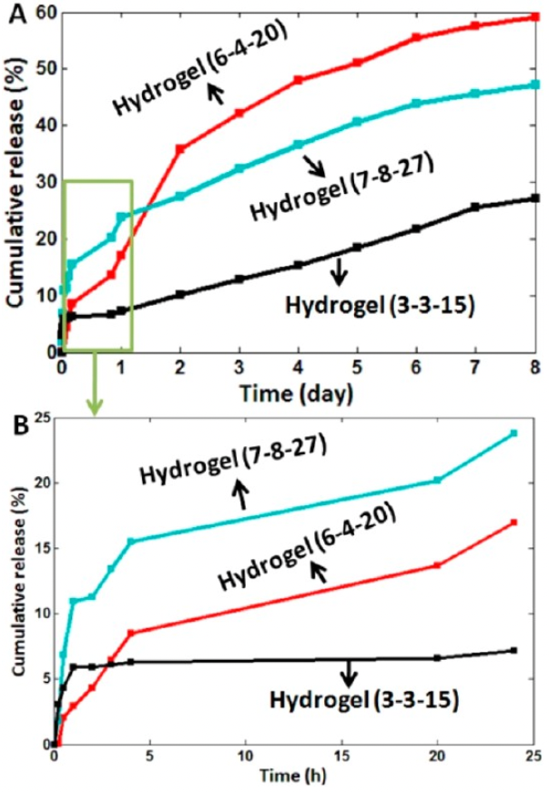
Sundew mucilage
Sundew
mucilage
Gland
Sundew mucilage
Bio-
inspiration
Sundew-inspired adhesive hydrogel
Investigation
Glucuronic acid & Mannose
(Backbone)
Arabinose & Galactose
(Side chains)
22 mM Ca²⁺
Sodium Alginate
(Similar to the backbone of Sundew)
Gum Arabic
(Same with the side chains of Sundew)
Ca²⁺
Stalk
Cumulative release (%)
Cumulative release (%)
Time (day)
Time (h)
Li, Mi, et al. "A bioinspired alginate-gum arabic hydrogel with micro-/nanoscale structures for controlled drug release in chronic wound healing." ACS applied materials & interfaces9.27 (2017): 22160-22175.

Slide 17
Virus-mimicking particles

Slide 18
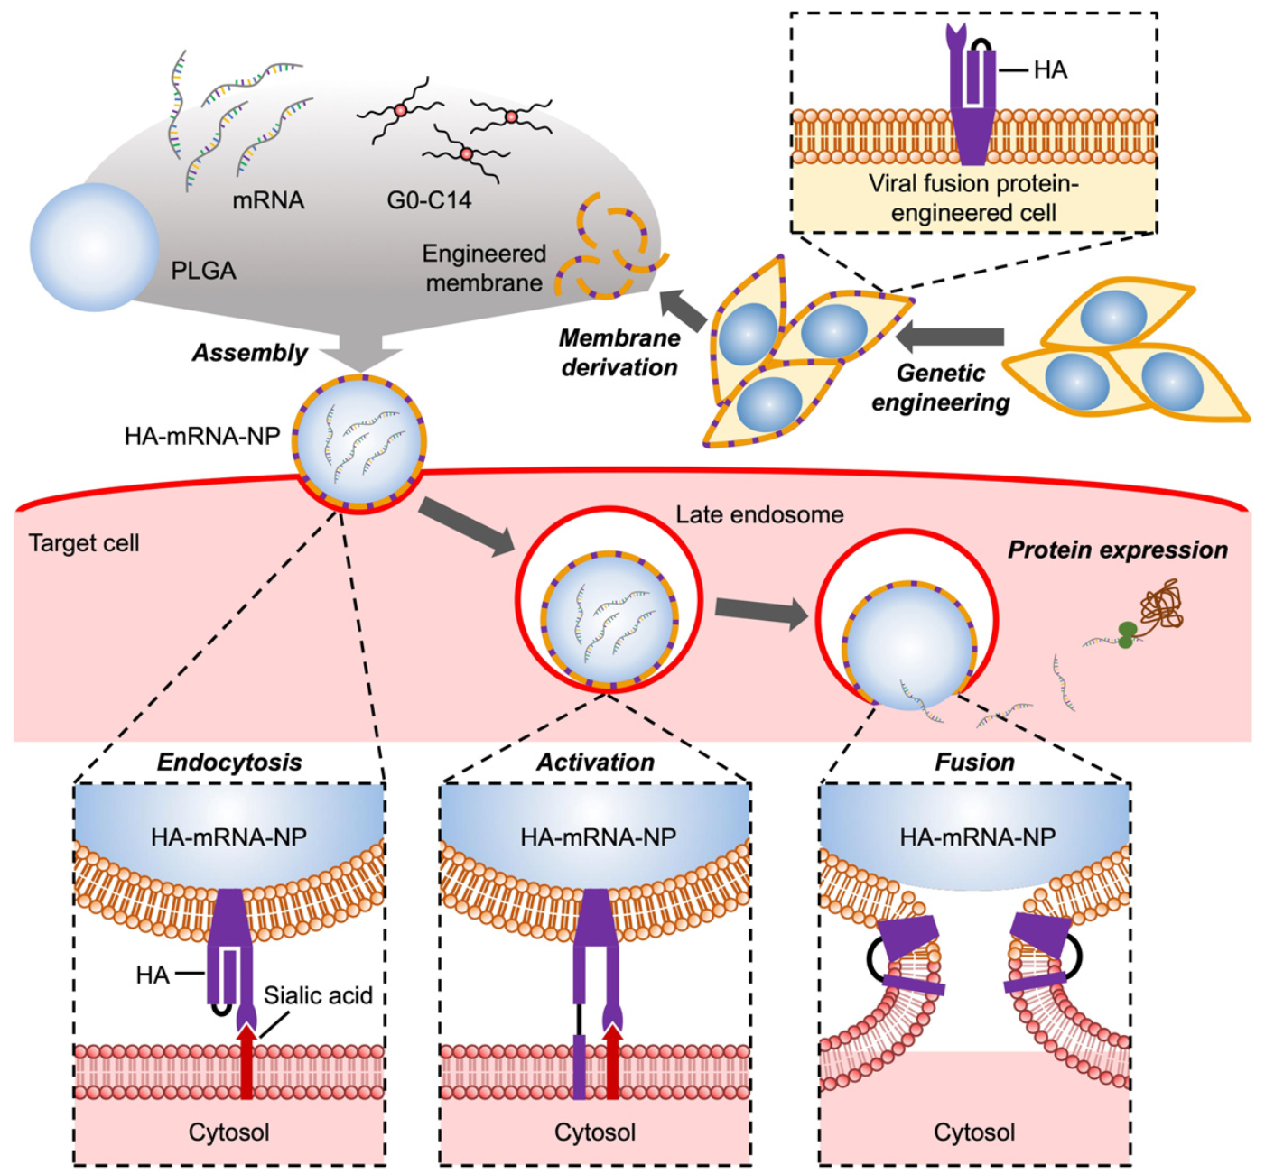
Endosomal escape
Park, Joon Ho, et al. "Virus‐mimicking cell membrane‐coated nanoparticles for cytosolic delivery of mRNA." Angewandte Chemie 134.2 (2022): e202113671.

Slide 19
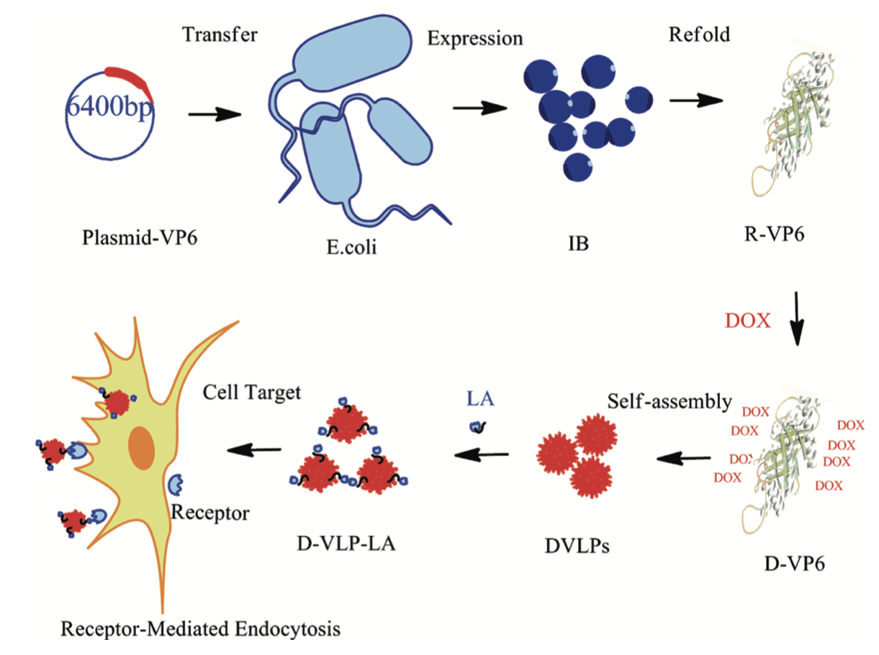
VP6-based system
Transfer
Expression
Refold
Plasmid-VP6
IB
R-VP6
E.coli
DOX
Cell Target
LA
Self-assembly
DOX
DOX
DOX
DOX
DOX
DOX
Receptor
D-VLP-LA
DOX
DOX
DVLPs
D-VP6
Receptor-Mediated Endocytosis
Zhao, Qinghuan, et al. "Self-assembled virus-like particles from rotavirus structural protein VP6 for targeted drug delivery." Bioconjugate chemistry 22.3 (2011): 346-352.

Slide 20
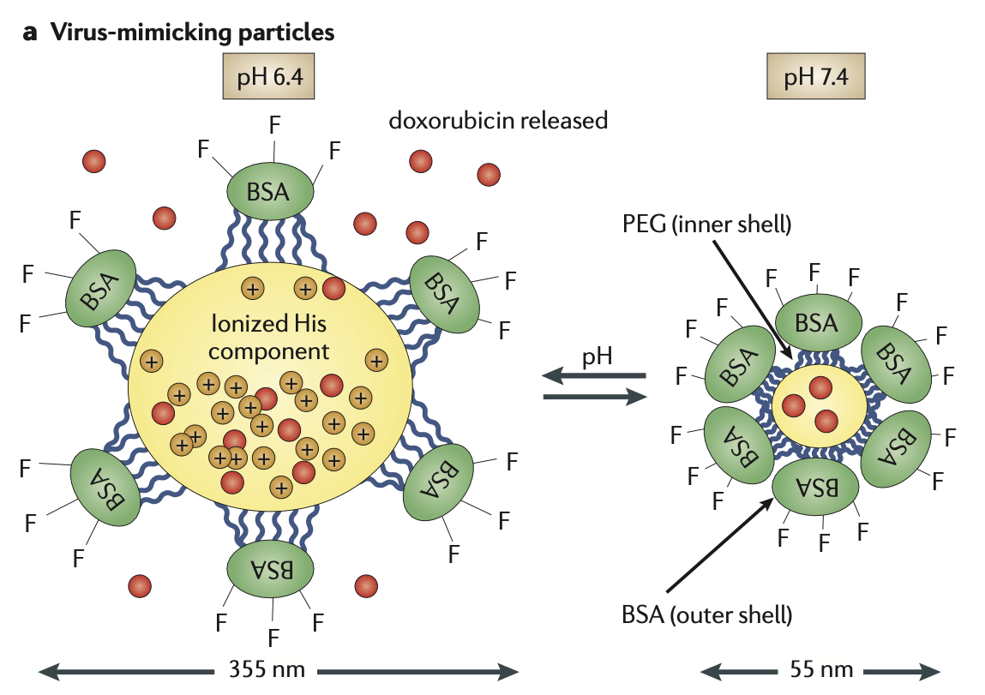
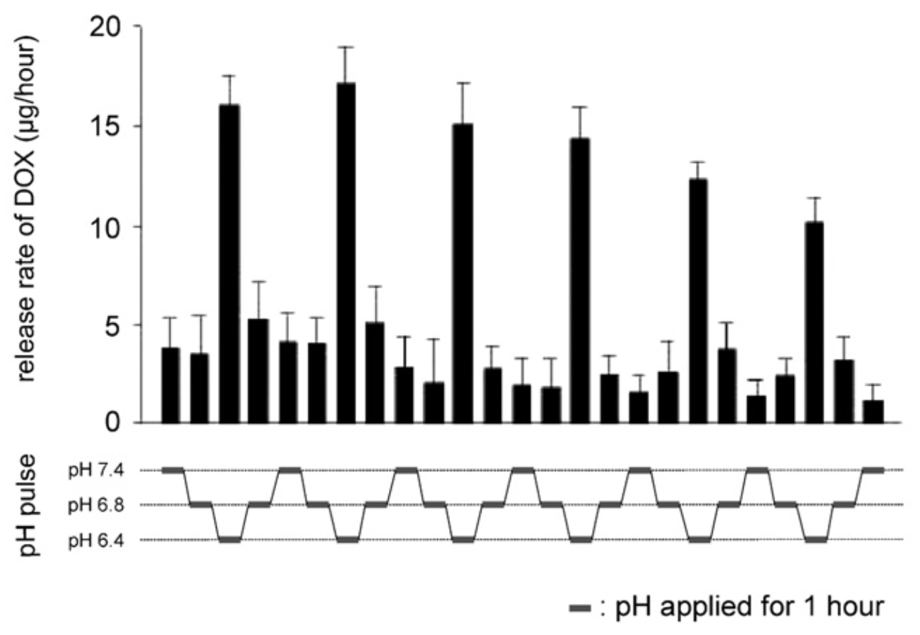
pH sensitive
Yoo, Jin-Wook, et al. "Bio-inspired, bioengineered and biomimetic drug delivery carriers." Nature reviews Drug discovery 10.7 (2011): 521-535.
Raemdonck, Koen, Joseph Demeester, and Stefaan De Smedt. "Advanced nanogel engineering for drug delivery." Soft Matter 5.4 (2009): 707-715.

Slide 21
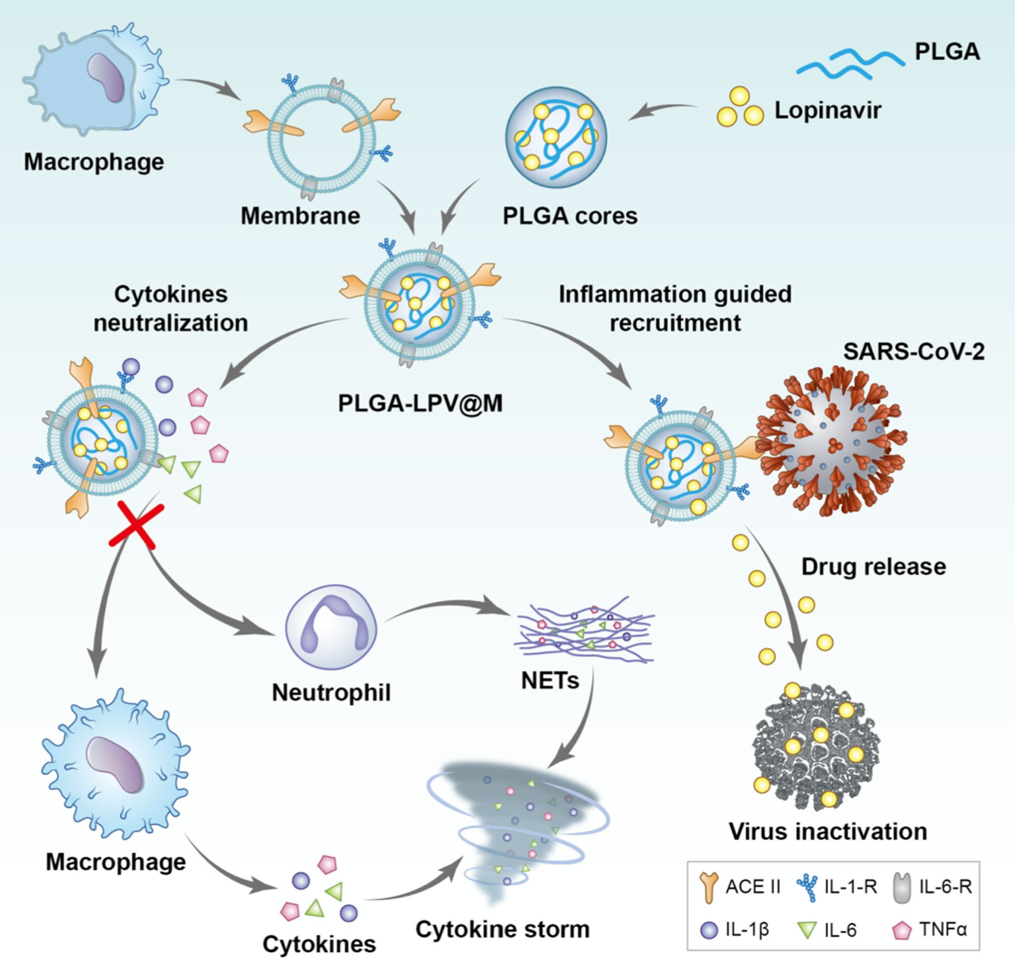
Macrophage nanocarriers
Tan, Qingqin, et al. "Macrophage biomimetic nanocarriers for anti-inflammation and targeted antiviral treatment in COVID-19." Journal of nanobiotechnology 19.1 (2021): 1-16.

Slide 22
Conclusion
Painless drug injection
Binding of drug carriers
Transferring the drug to the desired location
Biomimetic
Sustained and controlled drug release

Slide 23
References
Hwang, Jangsun, et al. "Biomimetics: forecasting the future of science, engineering, and medicine." International journal of nanomedicine 10 (2015): 5701.
B. Bhushan, "Biomimetics: lessons from nature–an overview," Philosophical Transactions of the Royal Society A: Mathematical, Physical and Engineering Sciences, vol. 367, no. 1893, pp. 1445-1486, 2009.
Guan, Qing-Fang, et al. "Bio-inspired lotus-fiber-like spiral hydrogel bacterial cellulose fibers." Nano letters 21.2 (2021): 952-958.
Singh, Charanpreet, and Xungai Wang. "A biomimetic approach for designing stent-graft structures: Caterpillar cuticle as design model." Journal of the mechanical behavior of biomedical materials 30 (2014): 16-29.
Shokrollahi, Mahvash, et al. "Biomimetic double-sided polypropylene mesh modified by DOPA and ofloxacin loaded carboxyethyl chitosan/polyvinyl alcohol-polycaprolactone nanofibers for potential hernia repair applications." International Journal of Biological Macromolecules 165 (2020): 902-917.
Shelah, Ortal, et al. "Coral-derived collagen fibers for engineering aligned tissues." Tissue Engineering Part A 27.3-4 (2021): 187-200.
Peng, Qingfa, et al. "Recombinant spider silk from aqueous solutions via a bio-inspired microfluidic chip." Scientific reports6.1 (2016): 1-12.
Whittall, Dominic R., et al. "Host systems for the production of recombinant spider silk." Trends in Biotechnology 39.6 (2021): 560-573.
Gurera, Dev, Bharat Bhushan, and Navin Kumar. "Lessons from mosquitoes’ painless piercing." Journal of the mechanical behavior of biomedical materials 84 (2018): 178-187.

Slide 24
References
Gonzalez-Cruz, Pedro, et al. "Chemical treatment method for obtaining clean and intact pollen shells of different species." ACS biomaterials science & engineering 4.7 (2018): 2319-2329.
Wang, Yuetong, et al. "Pollen-inspired microparticles with strong adhesion for drug delivery." Applied Materials Today 13 (2018): 303-309.
Hall, Simon R., Helen Bolger, and Stephen Mann. "Morphosynthesis of complex inorganic forms using pollen grain templates." Chemical Communications 22 (2003): 2784-2785.
Sun, Leming, et al. "Sundew-inspired adhesive hydrogels combined with adipose-derived stem cells for wound healing." ACS applied materials & interfaces 8.3 (2016): 2423-2434.
Li, Mi, et al. "A bioinspired alginate-gum arabic hydrogel with micro-/nanoscale structures for controlled drug release in chronic wound healing." ACS applied materials & interfaces9.27 (2017): 22160-22175.
Park, Joon Ho, et al. "Virus‐mimicking cell membrane‐coated nanoparticles for cytosolic delivery of mRNA." Angewandte Chemie 134.2 (2022): e202113671.
Zhao, Qinghuan, et al. "Self-assembled virus-like particles from rotavirus structural protein VP6 for targeted drug delivery." Bioconjugate chemistry 22.3 (2011): 346-352.
Yoo, Jin-Wook, et al. "Bio-inspired, bioengineered and biomimetic drug delivery carriers." Nature reviews Drug discovery 10.7 (2011): 521-535.
Raemdonck, Koen, Joseph Demeester, and Stefaan De Smedt. "Advanced nanogel engineering for drug delivery." Soft Matter 5.4 (2009): 707-715.

Slide 25
The End
Thank you

